Slide 1


ANALYSIS OF MACHINE LEARNING, DEEP LEARNING, AND ARTIFICIAL NEURAL NETWORK APPROACHES FOR BREAST CANCER CLASSIFICATION
10th International Conference on System Modeling & Advancement in Research Trends (SMART-2021)
Elakiya Sivakumar, Anjana Anand, Sachin Gaurishankar Sarate
Department of Biomedical Engineering
SSN College of Engineering, Tamil Nadu, 603110,
Kalavakkam, Chennai, India

Slide 2

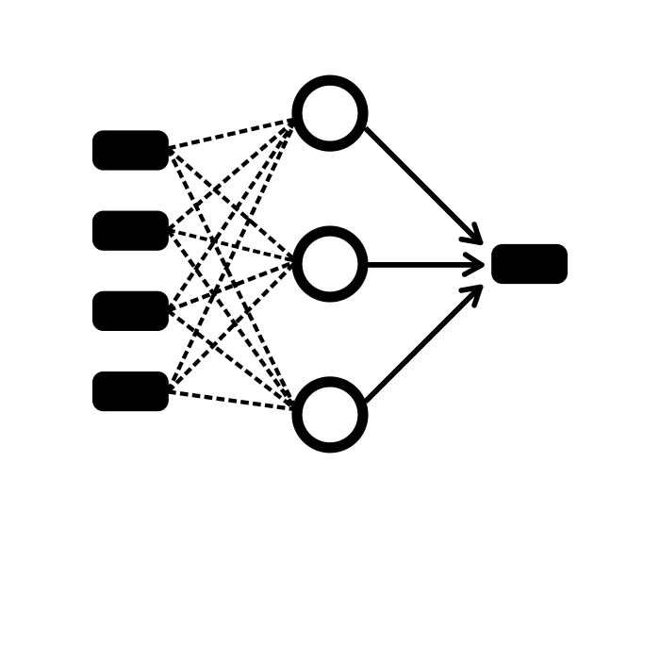



INTRODUCTION
Breast cancer is the leading cause of death in women.
About 31% of breast cancer are misdiagnosed.
This shows the need for an automated diagnostic assistance.
But what deep learning algorithm may be suitable for this process?
26%
Cancer Fatalities - Breast Cancer
Early detection can significantly improve the prognosis, significant cost savings.
STUDY
Supervised, semi-supervised and unsupervised learning models
Automated screening mechanism
Diagnostic assistant
Computer Assisted Diagnosis improves accuracy of the human physician as well as that of the algorithm
Wisconsin dataset - classification task
Jupiter
“Ease of implementation" - parameter
Jupiter is a gas giant and the biggest planet in the Solar System
Accuracy, ease of execution, availability of the modules, expertise level

Slide 3
DEFINING THE PROBLEM STATEMENT
“Finding the best algorithm for classification of Biomedical Dataset - Wisconsin Breast Cancer Dataset”
Parameters:
Accuracy
Learning - Supervised, Semi-Supervised, Unsupervised.
Ease of Implementation

Slide 4
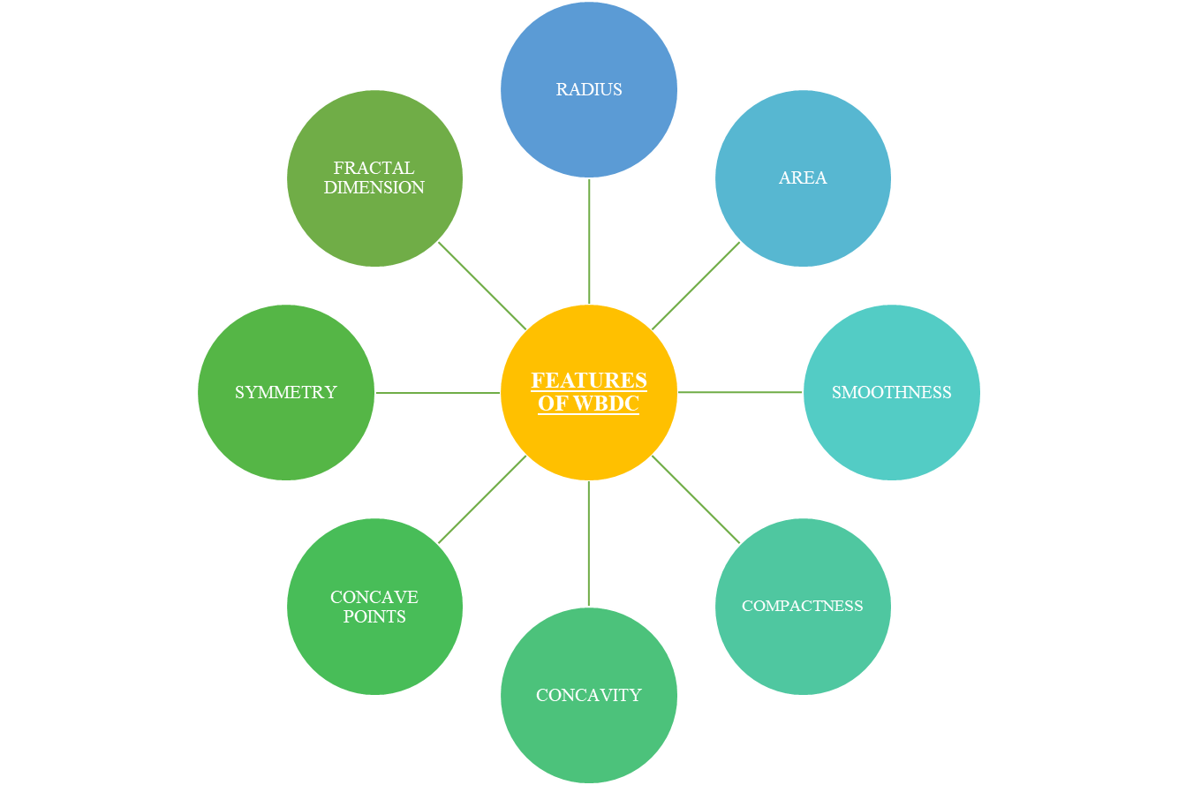
WISCONSIN BREAST CANCER DATASET
Malignant or benign type cancer
“Number score” assigned
"CSV" file that was published by the University of California, Irvine Public Repository
Digital image of a fine-needle aspiration of a human breast lump

Slide 5
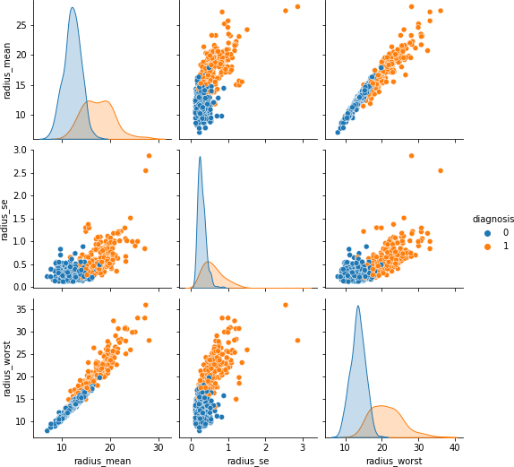
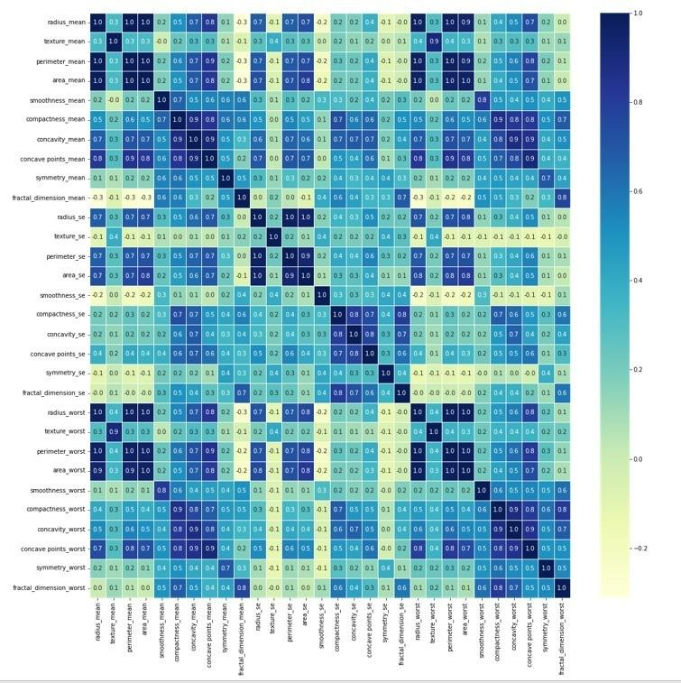
WISCONSIN BREAST CANCER DATASET - FEATURES
Distribution of Malignant and Benign tumor in the "radius" parameters of the Wisconsin Dataset
Heat Map of the Wisconsin Breast Cancer Dataset
The dataset is not distributed evenly.
Thus, we explored the effect that dropping extreme data features (“worst”) would have on the accuracy of the algorithm.
Since this is dropping of data, we hypothesized a reduction of accuracy which was later supported by the results.

Slide 6
MODEL ARCHITECTURES

Slide 7
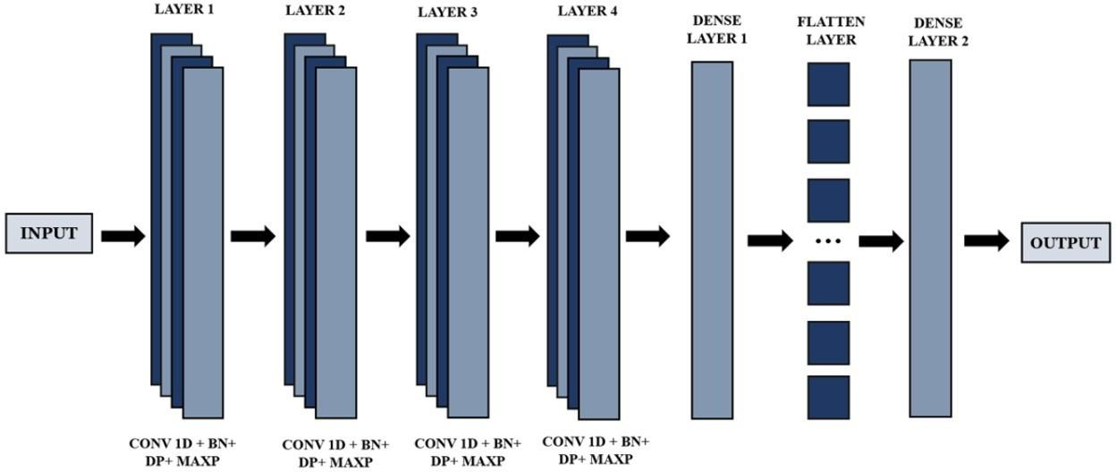
1D CNN
Several non-linearing units that are combined to produce output.
Dataset has dimensions (x, 9) - we use a 1D CNN to perform the convolution
Traditional convolution neural network model with blocks of convolution followed by batch normalization and drop out layers
1D CNN Architecture employed for binary classification
Batch normalization - to boost accuracy and speed up the training process. Dropout Layer was added as well.

Slide 8
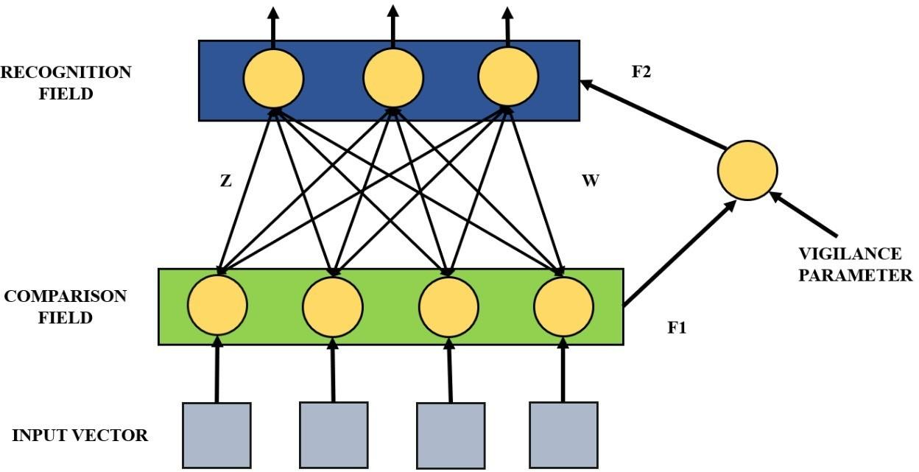
ADAPTIVE RESONANCE THEORY
Input is a vectorized data that causes a map-like firing in each layer of the ART
The topology of the input pattern is preserved in the output of the ART network
ART uses unsupervised learning; does not require "target" values
Model calculates score; weights are normalized to 0 and 1 values; output is a binary matrix - classifies between "malignant" and "benign"
Adaptive Resonance Theory Model simplified

Slide 9
GRAPH WAVELET NEURAL NETWORK
Operates in the spectral domain; learning is semi-supervised
Employs graph wavelet transformation
by a fast algorithm before convolution is performed
Required changing to text file format as
well as parsing of the input for the model
4-layer GWNN; performed Fourier
transforms and wavelet transformations on the data

Slide 10
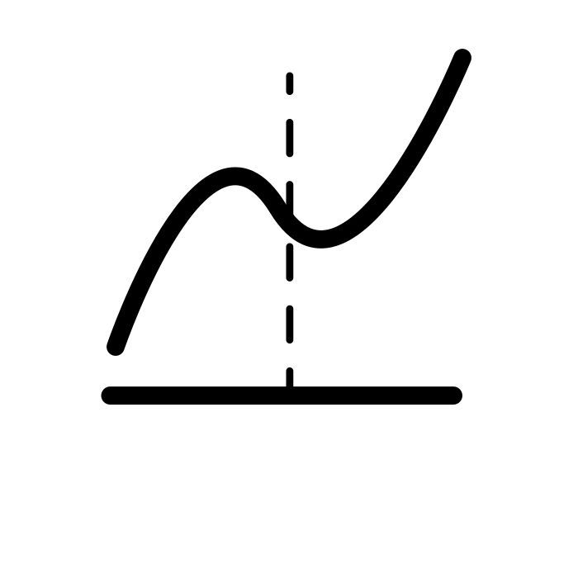
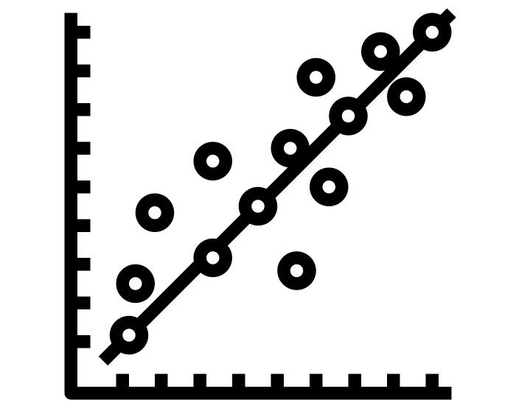

MACHINE LEARNING
LOGISTIC REGRESSION
Involves linear and non-linear models which analyze the data and group them using their features
LINEAR REGRESSION
Regression models were found to perform moderately well on the dataset
MODELS
STOCHASTIC GRADIENT DESCENT (SDG)
Accuracy improved when the input data included the “worst” parameters
SDG and SVM were markedly better for the same dataset

Slide 11
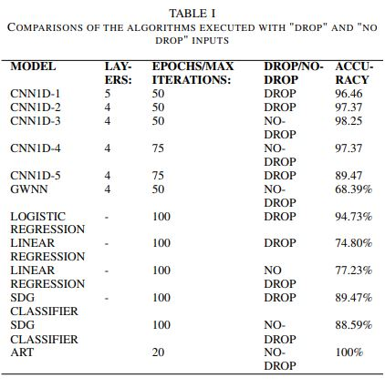
CONSOLIDATED RESULTS

Slide 12
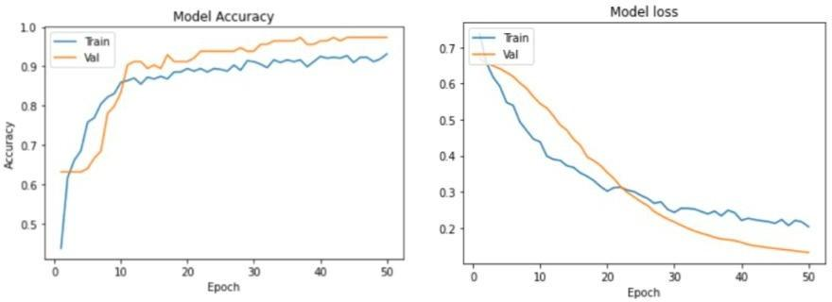
RESULTS FOR 1D CNN
Accuracy and Loss plots for 1D CNN

Slide 13
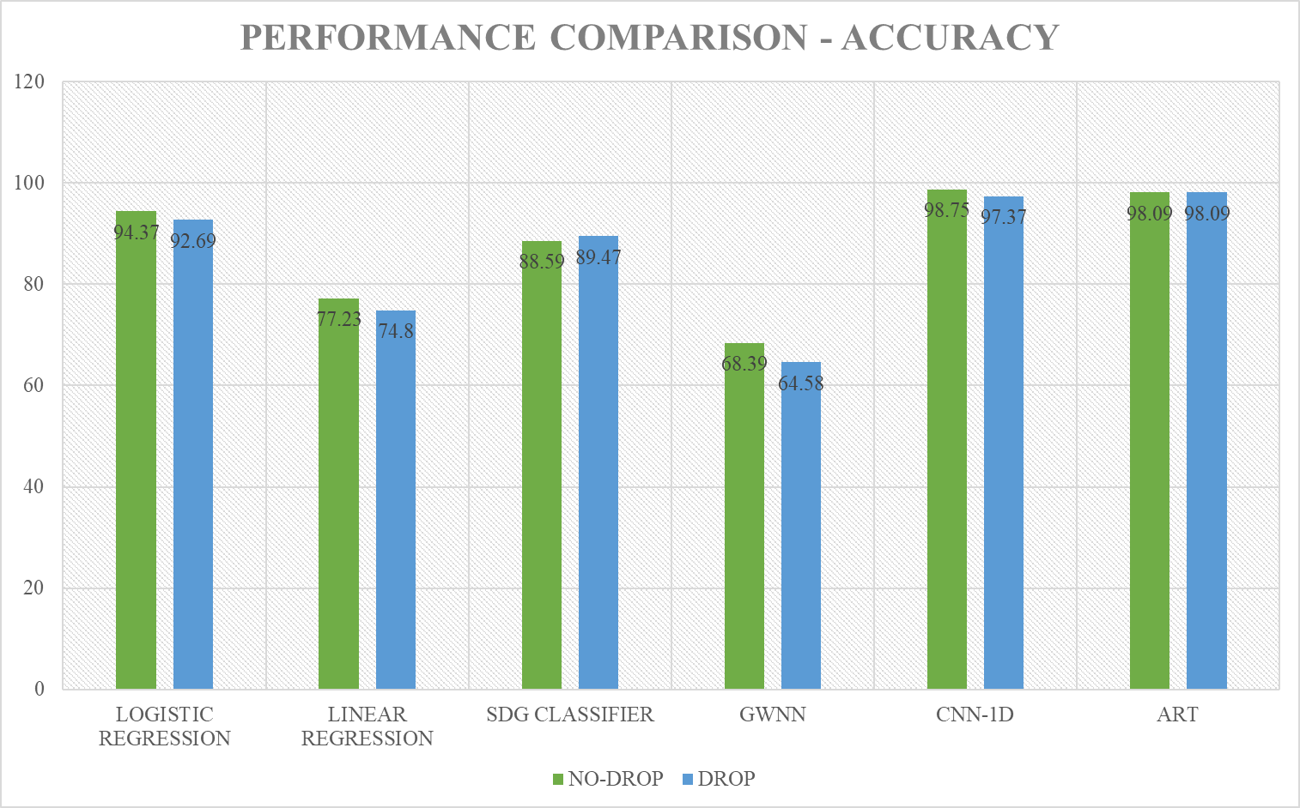
RESULTS

Slide 14
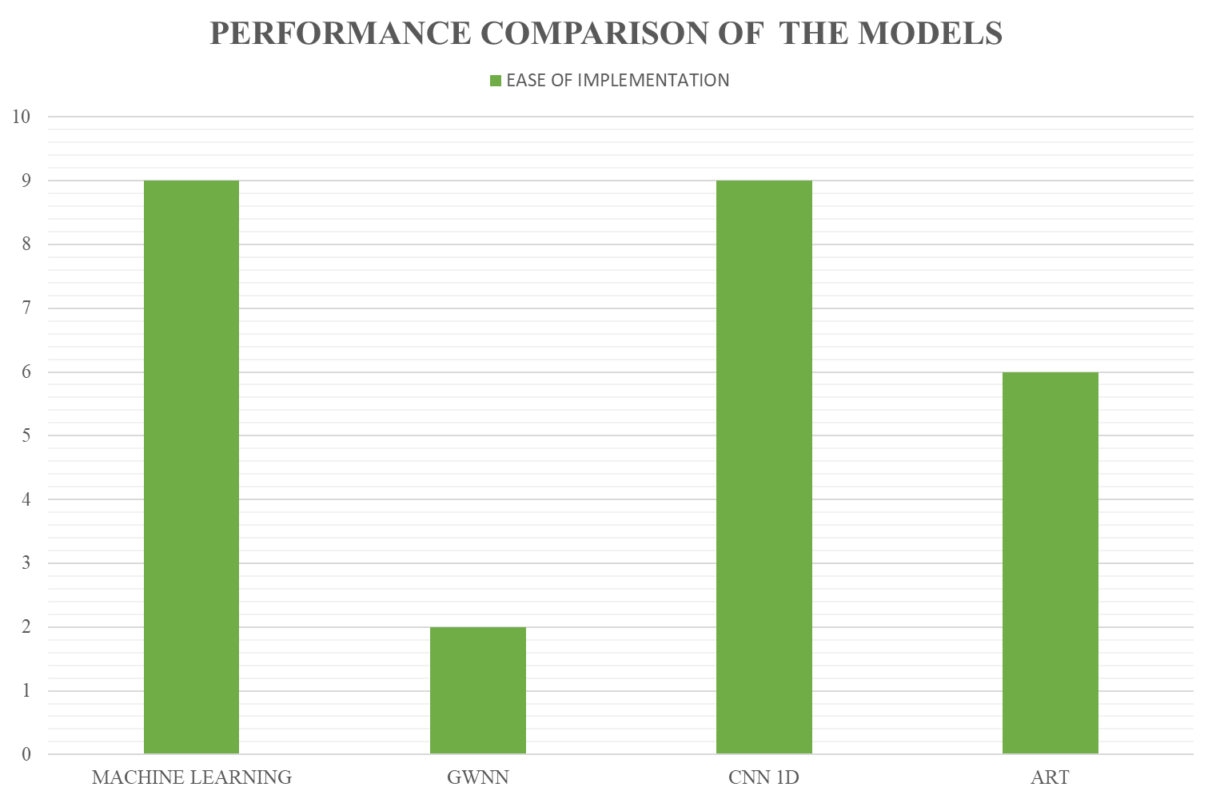
RESULTS

Slide 15
CONCLUSION
Performed dropping of the parameters labeled "worst" to test the accuracy scores of the model-
obtained lower accuracy for the models trained on "dropped" inputs consistently
Linear Regression, Logistic Regression, and SDG- accuracy scores less than adequate for general use; adjustments made to improve the accuracy of the models
Could not achieve high accuracy with the Graph wavelet neural network for the Wisconsin Dataset - requires domain expertise to be able to execute; model not recommended

Slide 16
CONCLUSION
Performed dropping of the parameters labeled "worst" to test the accuracy scores of the model-
obtained lower accuracy for the models trained on "dropped" inputs consistently
Performed dropping of the parameters labeled "worst" to test the accuracy scores of the model-
obtained lower accuracy for the models trained on "dropped" inputs consistently
ART is viable for biomedical applications -
Adaptive Resonance Theory (ART) network, gave best accuracy scores, architecture was trained on a smaller dataset and required domain knowledge to implement
1D CNN most suitable for practical application - results obtained better than most models while being practical to implement; math, data viz and front end tools required are easily accessible.

Slide 17
THANK YOU!

